Slide 1
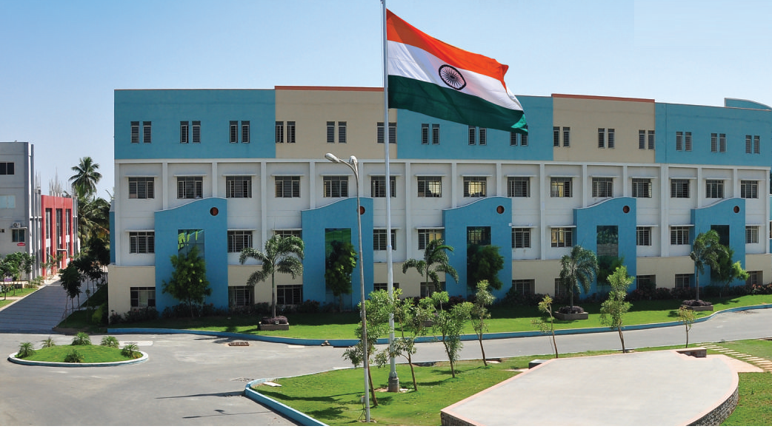
SRI ESHWAR COLLEGE OF ENGINEERING academic year: 2017-18 department: CIVIL section: 4TH Year
DESIGN PROJECT ZEROTH REVIEW
Date of review:07-07-2017

Slide 2
Title of the project
Batch Members
1. Aswath Kumar .N
2.Santhosh Raja .U.R
3. Pavithiran .T.S
Guide Name
Mr. Pradeep Kumar .D
Asst.Prof/Civil Dept.

Slide 3
Presentation Outline
Abstract
Literature Survey
Need for the study

Slide 4
Abstract of the project
Steel is the emerging solution and effective means for conventional construction of modern architectural steel structures.
The steel enables the platform for rapid,quicker,durable, replaceable and effective means of construction than the usage of conventional and primitive concrete structures.
This project summarizes the planning , analysis and designing of airport in Erode , which is completely a steel structure which satisfies all the needs of the society and the norms by overcoming the flaws and the typical structural contingencies.
Keywords : Steel , Steel structures, Effective , Emerging ,Modern .

Slide 5
Literature Survey (Cont’d..)
JOURNAL | Journal of Air Transport Management, 13(2), 97-103. doi: DOI: 10.1016/j.jairtraman.2006.10.002
TITLE | Development of level of service standards for airport facilities
AUTHOR(S) | Correia, A. R. & Wirasinghe, S. C. (2007).
INFERENCE | The main challenges faced during the construction of the airport by considering all the information studied and recorded for the effective construction of steel structured airport

Slide 6
Literature Survey (Cont’d..)
JOURNAL | Transportation Research Part A: Policy and Practice, 37(4), 315-331. doi: http://dx.doi.org/10.1016/S0965- 8564(02)00018-6
TITLE | Optimal terminal configurations for new large aircraft operations.
AUTHOR(S) | de Barros, A. G., & Wirasinghe, S. C. (2003).
INFERENCE | The basic amenities to be imparted in the terminal for the betterment of the passengers and to make it accessible for people from all walks

Slide 7
Literature Survey (Cont’d..)
JOURNAL | Airport Development Reference Manual. 9th 2013, from https://www.iata.org/publications/Documents/toc-adrm-9-ed-2004.pdf
TITLE | Planning & Design of Airports: McGraw Hill. IATA. (2004).
AUTHOR(S) | Horonjeff, R., McKelvey, F. X., Wiiliam, J. S., & Young, S. B. (2010).
INFERENCE | The detailed steps and procedures involved in the process of planning and design of airport along with the various techniques applies are studied

Slide 8
Literature Survey (Cont’d..)
JOURNAL | Paper presented at the 2nd International Conference on Construction and Project Management, Singapore.
TITLE | The Function of Creativity and Innovation In Architectural Design
AUTHOR(S) | Idi, D. B., Khaidzir, K. A. B. M., & Zeari, F. (2011).
INFERENCE | The modern architectural concepts and design of the airport terminal are analysed and the design and construction techniques to be adopted are explained.

Slide 9
Literature Survey (Cont’d..)
JOURNAL | Airport Cooperative Research Program, ACRP Report 40
TITLE | Airport Kerbside and Terminal Area Roadway, 2010.
AUTHOR(S) | Research report –ARCP -40
INFERENCE | The guide describes the unique operating characteristics of airport terminal area roadways and kerbside areas, and how their operations differ from those of urban streets and regional highways. The guide presents methods for estimating existing and future airport roadway requirements and alternative methods for analysing operations on airport roadways.

Slide 10
Literature Survey (Cont’d..)
JOURNAL | Airport Cooperative Research Program, ACRP Report 25
TITLE | Airport Passenger Terminal Planning and Design, Volume 1: Guidebook, 2010.
AUTHOR(S) | Research report -ACRP Report 25
INFERENCE | The guidebook is intended to supplement the guidebooks provided by the International Air Transport Association (IATA) and the Federal Aviation Administration (FAA) Advisory Circular documents with updated and new information for terminal planners, designers, and airport owners and operators.

Slide 11
Literature Survey (Cont’d..)
JOURNAL | Airport Cooperative Research Program,
TITLE | Elimination or Reduction of Baggage Recheck for Arriving International Passengers, 2012.
AUTHOR(S) | Research report -ACRP Report 61
INFERENCE | This report identifies potential alternative procedures that could be implemented to reduce or eliminate the need for the recheck of baggage for arriving international passengers at U.S. airports; evaluates the cost and benefits of for each alternative procedures to airports, airlines, and federal agencies; and compares the alternative procedures to current practices.

Slide 12
Literature Survey (Cont’d..)
JOURNAL | Airport Cooperative Research Program
TITLE | Innovations for Airport Terminal Facilities, 2008.
AUTHOR(S) | Research report - ACRP Report 10
INFERENCE | This report explores worldwide developments in airport landside facilities design, and examines future trends and innovative passenger service/processing concepts.

Slide 13
Literature Survey (Cont’d..)
JOURNAL | Airport Cooperative Research Program, ACRP Report 41
TITLE | Guide to the Decision-Making Tool for Evaluating Passenger Self-Tagging, 2010.
AUTHOR(S) | Research report - ACRP Report 41
INFERENCE | This report provides the information and tools necessary for an airport or airline to determine the appropriateness of pursuing passenger self-tagging.

Slide 14
Literature Survey (Cont’d..)
JOURNAL | Transportation Security Administration, Recommended Security
TITLE | Guidelines for Airport Planning, Design and Construction, May 2011.
AUTHOR(S) | Research report
INFERENCE | This document provides a guideline for planning, and design and construction of passenger security checkpoints facilities at airports.

Slide 15
Literature Survey (Cont’d..)
JOURNAL | Transportation Security Administration, Burns, Bob, Future Attribute Screening Technology Mobile Module, May 24, 2007.
TITLE | Transportation Security Administration, Burns, Bob, Future Attribute Screening Technology Mobile Module.
AUTHOR(S) | Research report
INFERENCE | This presentation provides an overview of the Transportation Security Administration’s program for an innovative passenger screening technology. The program identifies prototype solution concepts for field testing using mobile research and development tools.

Slide 16
Literature Survey (Cont’d..)
JOURNAL | Terminal Building, ATS, CNS Installation Building, Cargo & Aircraft Hanger
TITLE | Fire Prevention & Protection
AUTHOR(S) | Airport authority of India – FIRE ORDER -05
INFERENCE | Airport terminal building, ATS/CNS installation building and Airport Hanger are classified under Business-cum-Assembly and storage & hazardous based on the classification of building and hence are required to comply with proper fire prevention and fire protection, confirming to high hazard occupancy as per National Building Code (NBC) and also as per National Fire Protection Association (NFPA)/Bureau of Indian Standard (BIS).

Slide 17
Need for the study
To put the emerging issues into proper context, many began their discussions with a review of the fundamental trends that are now being faced in the airport and aviation industry.
Government downsizing and increased focus on public-private partnerships
Changes in the airline industry, including route structures and airline hubbing.
Continuing growth in the airline passenger and air cargo markets.

Slide 18
Need for the study
In considering these trends, it is clear that airports must be able to maintain a flexible response to the dynamics of an industry in which rapidly changing technology and political and economic events often affect and reshape all aspects of airport operations.

Slide 19
Work Schedule
S.NO | DATE | WORK TO BE DONE | REMARKS
1 | 24-04-2017 | Selection of Topic
2 | 02-05-2017 | Literature study
3 | 15-07-2017 | Planning
4 | 26-08-2017 | Design and generation of project
5 | 05-09-2017 | Book formation
6 | 25-09-2017 | Submission of project

Slide 20
Queries?

